Slide 1
Chapter 03
Object Oriented Programming (SEng 2202)
Inheritance and Polymorphism

Slide 2
Objectives
After studying this chapter, students should be able to learn:
Basics of Inheritance
Types of Inheritance
The protected modifier
Super and final key word
Polymorphism and its types
Method Overloading vs. Overriding
The Object class
The Abstract class

Slide 3
Introduction
Object-oriented programming (OOP) is popular because:
It enables reuse of previous code saved as classes
All Java classes are arranged in a hierarchy
Object is the superclass of all Java classes
Inheritance and hierarchical organization capture idea:
One thing is a refinement or extension of another
Reusability - building new classes by utilizing existing classes.

Slide 4
Inheritance - Introduction
It is always good/“productive” if we are able to reuse something that is already exists rather than creating the same all over again.
This is achieved by creating new classes, reusing the data members and methods of existing classes.
This mechanism of deriving a new class from existing/old class is called “inheritance”.
The old class is known as “base” class, “super” class or “parent” class”; and the new class is known as “sub” class, “derived” class, or “child” class.

Slide 5
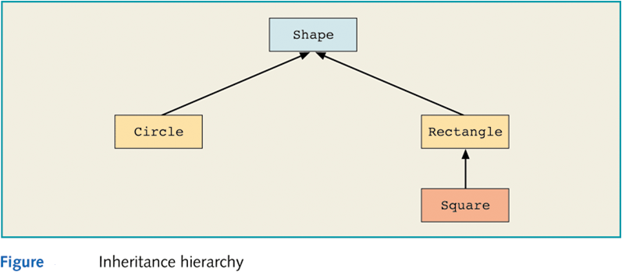
Examples
Parent
subclass
or
derived class
superclass
or
base class
Inherited capability
extends
Child

Slide 6
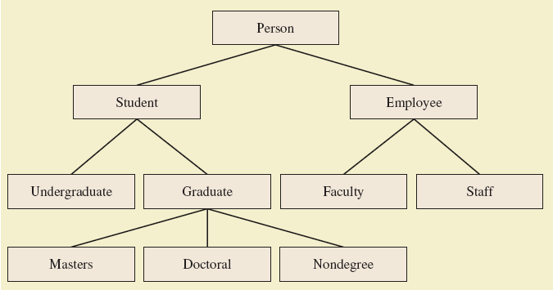
Examples – Contd.
Figure : Class Hierarchies

Slide 7
Contd.
Inheritance relationships often are shown graphically in a UML class diagram, with an arrow with an open arrowhead pointing to the parent class.
Vehicle
Car
Inheritance should create an is-a relationship, meaning the child is a more specific version of the parent.

Slide 8

Declaring Sub classes
In Java, we use the reserved word extends to establish an inheritance relationship
Example:
class subclass-name extends superclass-name
{
…………
…………
}
class Car extends Vehicle
{
// class contents
}

Slide 9
Types of Inheritance
The different types of inheritance are:
Single inheritance (only one super class)
Multiple inheritance (several super classes, not supported by Java)
Hierarchical inheritance (one super class, many sub classes)
Multi-Level inheritance (derived from a derived class)
Hybrid inheritance (more than two types)
Multi-path inheritance (inheritance of some properties from two sources).

Slide 10
Types of Inheritance
A
A
B
A
B
C
B
C
D
(a) Single Inheritance
(b) Multiple Inheritance
(c) Hierarchical Inheritance
A
A
A
B
C
B
C
B
C
D
D
(d) Multi-Level Inheritance
(e) Hybrid Inheritance
(f) Multipath Inheritance

Slide 11
The protected Modifier
Visibility modifiers determine which class members are inherited and which are not
Variables and methods declared with public visibility are inherited; those with private visibility are not
But public variables violate the principle of encapsulation
There is a third visibility modifier that helps in inheritance situations: protected

Slide 12
The protected Modifier
The protected visibility modifier allows a member of a base class to be accessed in the child
protected visibility provides more encapsulation than public does
protected visibility is not as tightly encapsulated as private visibility
Modifier | Class | Package | Subclass | World
public | Y | Y | Y | Y
protected | Y | Y | Y | N
none | Y | Y | N | N
private | Y | N | N | N

Slide 13
Single Inheritance - Example
Person class contains general details of a
person
public class Person {
String name;
String permanentAddress;
int age;
void set_PermanentDetails(String name, String permanentAddress, int age) {
this.name = name;
this.permanentAddress = permanentAddress;
this.age = age;
}
void get_PermanentDetails() {
System.out.println("Name : " + name);
System.out.println("Permanent Address : " + permanentAddress);
System.out.println("Age :" + age);
}
}

Slide 14
Contd.
Employ contains company details of a person.
Reuse the general details of the
person in its sub class.
class Employ extends Person {
int id;
String companyName;
String companyAddress;
Employ(int id, String name, String permanentAddress, int age,
String companyName, String companyAddress) {
this.id = id;
set_PermanentDetails(name, permanentAddress, age);
this.companyName = companyName;
this.companyAddress = companyAddress;
}
void get_EmployDetails() {
System.out.println("Employ Id : " + id);
get_PermanentDetails();
System.out.println("Company Name : " + companyName);
System.out.println("Company Address : " + companyAddress);
}
}

Slide 15
Contd.
class InherDemo {
public static void main(String args[]) {
Employ e1 = new Employ(101,”Abebe”, "Addis Ababa, Ethiopia",
29, "ASTU", "Adama, Ethiopia");
e1.get_EmployDetails();
}
}
Output:
Employ Id : 101
Name : Abebe
Permanent Address : Addis Ababa, Ethiopia
Age :29
Company Name : ASTU
Company Address : Adama, Ethiopia

Slide 16
Multilevel Inheritance - Example
public class Student {
int id;
Scanner in = new Scanner(System.in);
void readdata1() {
System.out.print("Enter your Id: ");
id = in.nextInt();
}
void printdata1() {
System.out.println("Id = " + id);
}
}

Slide 17
Contd.
class Exam extends Student {
int m1, m2, m3;
Scanner in = new Scanner(System.in);
void readdata2() {
readdata1();
System.out.print("Enter 3 subjects marks:");
m1 = in.nextInt();
m2 = in.nextInt();
m3 = in.nextInt();
}
void printdata2() {
printdata1();
System.out.println("Subject1 marks=" + m1);
System.out.println("Subject2 marks=" + m2);
System.out.println("Subject3 marks=" + m3);
}
}

Slide 18
Contd.
class Results extends Exam {
int avg;
void printdata3() {
printdata2();
avg = (m1 + m2 + m3) / 3;
if (avg < 35) {
System.out.println("Grade: F");
} else if (avg >= 35 && avg < 50) {
System.out.println("Grade: D");
} else if (avg >= 50 && avg < 60) {
System.out.println("Grade: C");
} else if (avg >= 60 && avg < 75) {
System.out.println("Grade: B");
} else if (avg >= 75) {
System.out.println("Grade: A");
}
}
}

Slide 19
Contd.
class MultiInh {
public static void main(String sad[]) {
Results obj = new Results();
obj.readdata2();
obj.printdata3();
}
}
Output:
Enter your Id: 101
Enter 3 subjects marks:75 82 95
Id = 101
Subject1 marks=75
Subject2 marks=82
Subject3 marks=95
Grade: A

Slide 20
The use of “super” keyword
‘super’ is a keyword used to refer to hidden variables of super class from sub class.
super.a=a;
It is used to call a constructor of super class from constructor of sub class which should be first statement.
super(a,b);
It is used to call a super class method from sub class method to avoid redundancy of code
super.addNumbers(a, b);

Slide 21
“super” and hiding
Why is super needed to access super-class members?
When a sub-class declares the variables or methods with the same names and types as its super-class:
class A {
int i = 1;
}
class B extends A {
int i = 2;
System.out.println(“i is “ + i);
}
The re-declared variables/methods hide those of the super-class.

Slide 22
“super” - Example
class A {
int i;
}
class B extends A {
int i;
B(int a, int b) {
super.i = a;
i = b;
}
void show()
{
System.out.println("i in superclass: " + super.i);
System.out.println("i in subclass: " + i);
}
}

Slide 23
Contd.
Although the i variable in B hides the i variable in A, super allows access to the hidden variable of the super-class:
class UseSuper {
public static void main(String args[]) {
B subOb = new B(1, 2);
subOb.show();
}
}

Slide 24
Multiple Inheritance
Multiple inheritance allows a class to be derived from two or more classes, inheriting the members of all parents
Collisions, such as the same variable name in two parents, have to be resolved
Java does not support multiple inheritance
In most cases, the use of interfaces gives us aspects of multiple inheritance without the overhead.

Slide 25
Using final keyword with Inheritance
final keyword is used declare constants which can not change its value of definition.
final variables can not change its value.
final methods can not be Overridden or Overloaded
final Classes can not be extended or inherited

Slide 26
Preventing Overriding with final
A method declared final cannot be overridden in any sub-class:
class A {
final void meth() {
System.out.println("This is a final method.");
}
}
This class declaration is illegal:
class B extends A {
void meth() {
System.out.println("Illegal!");
}
}

Slide 27
Contd.
A class declared final cannot be inherited – has no sub-classes.
final class A { … }
This class declaration is considered illegal:
class B extends A { … }
Declaring a class final implicitly declares all its methods final.
It is illegal to declare a class as both abstract and final.

Slide 28
The Benefits of Inheritance
Code reusability:- Inheritance automates the process of reusing the code of the super classes in the subclasses.
With inheritance, an object can inherit its more general properties from its parent object, and that saves the redundancy in programming.
Code maintenance:- Organizing code into hierarchical classes makes its maintenance and management easier.
Implementing OOP:- Inheritance helps to implement the basic OOP philosophy to adapt computing to the problem and not the other way around, because entities (objects) in the real world are often organized into a hierarchy.
Increased Reliability (resulting from reuse and sharing of well-tested code)

Slide 29
Aggregation
Aggregation in Java is a relationship between two classes that is best described as a "has-a" and "whole/part" relationship.
It is a more specialized version of the association relationship. The aggregate class contains a reference to another class and is said to have ownership of that class.
Each class referenced is considered to be part-of the aggregate class.
For example, if you imagine that a Student class that stores information about individual students at a school. Now assume a Subject class that holds the details about a particular subject
If the Student class is defined to contain a Subject object then it can be said that the Student object has-a Subject object.
The Subject object also makes up part-of the Student object after all, there is no student without a subject to study. The Student object, therefore, owns the Subject object.

Slide 30
Contd…
public class Subject { private String name; public void setName(String name) { this.name = name; } public String getName() { return name; }
} public class Student { private Subject[] studyAreas = new Subject[10]; //the rest of the Student class }
What is the relation ship b/n Address and Employee class?

Slide 31
Polymorphism
Polymorphism came from the two Greek words ‘poly’ means many and morph means forms i.e. many forms
If the same method has ability to take more than one form to perform several tasks then it is called polymorphism.
A polymorphic reference is a variable that can refer to different types of objects at different points in time.
It is of two types: Static Polymorphism and Dynamic Polymorphism.
Static Polymorphism:
The polymorphism exhibited at compile time is called Static polymorphism.
Here the compiler knows which method is called at the compilation. This is also called compile time polymorphism or static binding.
Achieving method overloading & method overriding using private, static and final methods is an example of Static Polymorphism.

Slide 32
Static Polymorphism
class Animal
{static void move ()
{ System.out.println ("Animals can move");
}
}
class Dog extends Animal
{
static void move ()
{ System.out.println ("Dogs can walk and run");
}
}
public class StaticPoly
{ public static void main(String args[])
{ Animal.move ();
Dog.move ();
}
}

Slide 33
Polymorphism – Contd.
Dynamic Polymorphism:
The polymorphism exhibited at run time is called dynamic polymorphism.
In this dynamic polymorphism a method call is linked with method body at the time of execution by JVM.
Java compiler does not know which method is called at the time of compilation. This is also known as dynamic binding or run time polymorphism.
Method overloading and method overriding are examples of Dynamic Polymorphism in Java.
Provided that the methods are instance method.

Slide 34
Dynamic Polymorphism - overloading
class Sample
{ void add(int a,int b)
{
System.out.println ("sum of two="+ (a+b));
}
void add(int a,int b,int c)
{
System.out.println ("sum of three="+ (a+b+c));
}
}
class OverLoad
{ public static void main(String[] args)
{ Sample s=new Sample ( );
s.add (20, 25);
s.add (20, 25, 30);
}
}

Slide 35
Method Overriding
Writing two or more methods in super & sub classes with same name and same signatures is called method overriding.
In method overriding JVM executes a method depending on the type of the object.
class Animal
{
void move()
{
System.out.println ("Animals can move");
}
}
class Dog extends Animal
{ void move()
{
System.out.println ("Dogs can walk and run");
}
}

Slide 36
Contd.
public class OverRide
{ public static void main(String args[])
{
Animal a = new Animal (); // Animal reference and object
Animal b = new Dog (); // Animal reference but Dog object
a.move(); // runs the method in Animal class
b.move(); //Runs the method in Dog class
}
}

Slide 37
Overloading Vs Overriding
Overloading deals with multiple methods in the same class with the same name but different signatures
Overloading lets you define
a similar operation in different ways for different data
Overriding deals with two methods, one in a parent class and one in a child class, with the same and signature
Overriding lets you define a similar operation in different ways for different object types

Slide 38
The Object Class
A class called Object is defined in the java.lang package of the Java standard class library
All classes are derived from the Object class
If a class is not explicitly defined to be the child of an existing class, it is assumed to be the child of the Object class
Therefore, the Object class is the ultimate root of all class hierarchies.
The Object class contains a few useful methods, which are inherited by all classes
For example, the toString method is defined in the Object class
Every time we define the toString method, we are actually overriding an inherited definition

Slide 39
Contd.
The toString method in the Object class is defined to return a string that contains the name of the object’s class along with some other information
The equals method of the Object class returns true if two references are aliases
We can override equals in any class to define equality in some more appropriate way
As we've seen, the String class defines the equals method to return true if two String objects contain the same characters
The designers of the String class have overridden the equals method inherited from Object in favor of a more useful version

Slide 40
The Abstract Class
A method with method body is called concrete method. In general any class will have all concrete methods.
A method without method body is called abstract method. A class that contains abstract method is called abstract class. i.e. An abstract class is a class with zero or more abstract methods
It is possible to implement the abstract methods differently in the subclasses of an abstract class.
These different implementations will help the programmer to perform different tasks depending on the need of the sub classes.
Moreover, the common members of the abstract class are also shared by the sub classes.

Slide 41
Contd.
The abstract methods and abstract class should be declared using the keyword abstract.
We cannot create objects to abstract class because it is having incomplete code.
Whenever an abstract class is created, subclass should be created to it and the abstract methods should be implemented in the subclasses, then we can create objects to the subclasses.
Abstract class reference can be used to refer to the objects of its sub classes.
Abstract class references cannot refer to the individual methods of sub classes.
A class cannot be both ‘abstract’ & ‘final’ simultaneously
e.g.: final abstract class A // invalid

Slide 42
Example – Abstract class
abstract class Figure
{ double dim1;
double dim2;
Figure (double a, double b)
{ dim1 = a;
dim2 = b;
}
abstract double area ();// area is an abstract method
}
class Rectangle extends Figure
{
Rectangle (double a, double b)
{
super(a,b);
}
double area () // override area for rectangle
{ System.out.println ("Inside Area of Rectangle.");
return dim1 * dim2;
}
}

Slide 43
Contd.
class Triangle extends Figure
{ Triangle (double a, double b)
{ super (a, b);
}
double area() // override area for right triangle
{ System.out.println ("Inside Area of Triangle.");
return dim1 * dim2 / 2;
}
}
class AbstractAreas
{ public static void main(String args[])
{ // Figure f = new Figure(10, 10); // illegal now
Rectangle r = new Rectangle(9, 5);
Triangle t = new Triangle(10, 8);
System.out.println("Area is " + r.area());
System.out.println("Area is " + t.area());
}
}

Slide 44
Review Questions
What is inheritance? What is a superclass? What is a subclass?
Which class is at the top of the class hierarchy in Java?
What are the constructor issues surrounding inheritance?
What is method overriding? What is polymorphism? How are they related?
What is a final method? What is a final class? What is final variable?

